Slide 1
Setting Catches for Stocks with Catch Data Only
Presented by:
Dr. Jim Berkson
Notes:
> Slide <
Acceptable Biological Catch
Slide 2, please

Slide 2
Establishing catch limits
Detective work
What data do I have?
What output do I need?
What assumptions am I willing to make?
What role does uncertainty play?

Slide 3
Case 1: Catch Only
What does having a time series of catch tell you about the dynamics of your stock?
Can you have catch increasing over time and
Your population decreasing?
Your population increasing?
What can you do in this case?

Slide 4
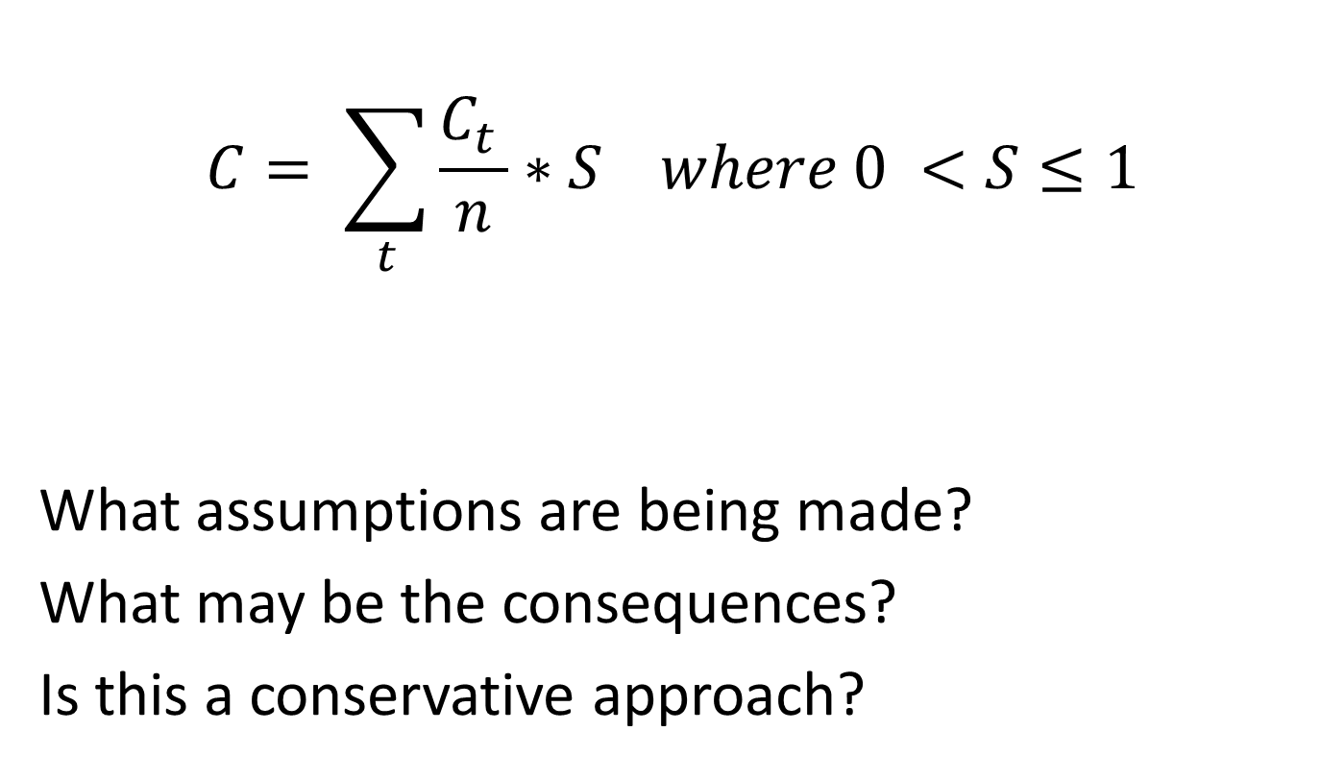
A scalar approach
$$C= \sum_{t}{\frac{C_{t }}{n}∗S where 0 <S≤1}$$
What assumptions are being made?
What may be the consequences?
Is this a conservative approach?
Restrepo et al. 1998

Slide 5
Let’s assume you know a little bit about your stock and its status.
Can you make an educated guess at to whether your stock is lightly exploited, moderately exploited, or highly exploited?
Berkson et al. 2011

Slide 6
Evidence-based scoring system
Attribute | Lightly Exploited (1) | Moderately Exploited (2) | Heavily Exploited (3)
Overall fishery exploitation based on assessed stocks | All known stocks are either moderately or lightly exploited. | Most stocks are moderately exploited. No more than a few overfished stocks. | Many stocks are overfished.
Bycatch or actively targeted by the fishery | No targeted fishery. | Occasionally targeted, but occurs in a mix with other species. | Actively targeted.
Natural mortality compared to dominant species in the fishery | Higher or equal to dominant species. | Equal to dominant species. | Less than dominant species.
Six other attributes
Notes:
The question is, if you only have reliable catch data, how do you know whether the stock is lightly, moderately, or heavily exploited?
> Slide <
Experts, such as the SSC, go though this process and score each of the 9 attributes, then average the score to determine the status of the stock.
Slide 12, please.

Slide 7
Potential management objectives depending on stock status for ORCS Working Group method
Stock status | Potential management objectives
Lightly exploited | Maintain current catch levels or allow for limited increases in catch.
Moderately exploited | Maintain current catch levels.
Heavily exploited, possibly overfished | Reduce catches to end overfishing
Notes:
Each of the three regions has an associated management objective:
Lightly exploited (B > B at 65% of unfished levels)
Moderately exploited (B between 19% and 65% - pgy range)
Heavily exploited (B < B at 19% of unfished levels)
Slide 11, please.

Slide 8
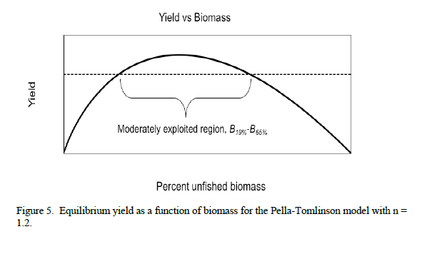

Slide 9
Recommended Catches
Stock Category
Lightly exploited (B > B_{65%}) | Moderately exploited (B ~ B_{MSY}) | Heavily exploited (B < B_{20%})
2.0 x catch statistic | 1.0 x catch statistic | 0.5 x catch statistic
What are the possible problems with this approach?
Notes:
Next, to calculate the stocks OFL, you use a catch statistic, such as the average catch over the time period, and multiply it by a scalar, depending on the stock’s status.
> Slide <
Scalar values actually have a basis in population dynamics theory.
Next slide, please.

Slide 10
Let’s look at some approaches that are more quantitative in nature.
What if you have a time series (or partial time series) of catch?

Slide 11
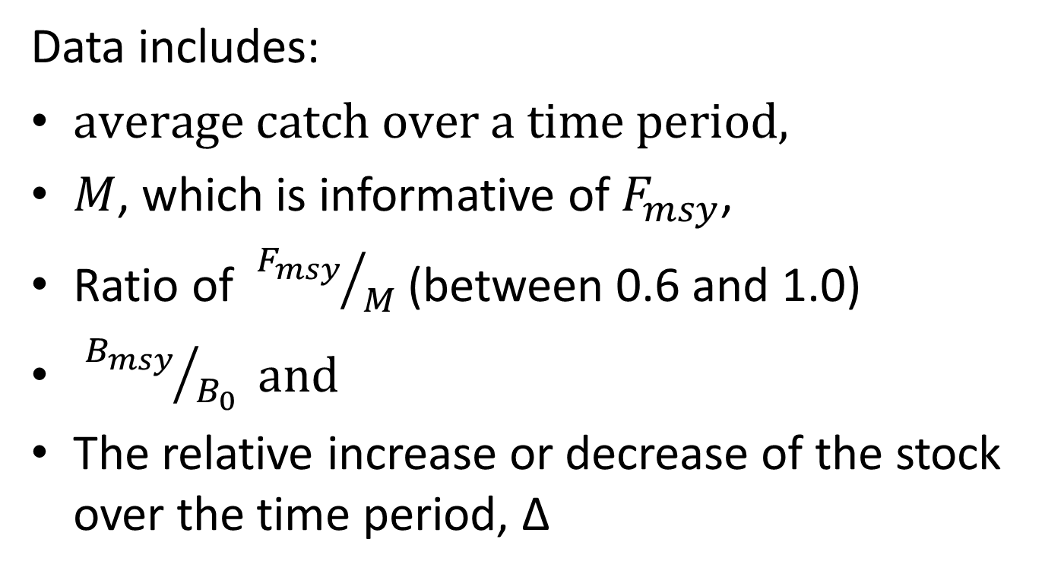
Depletion-Corrected Average Catch DCAC
Data includes:
$average catch over a time period,$
$M$, which is informative of $F_{msy}$,
Ratio of ${F_{msy}}/M$ (between 0.6 and 1.0)
${B_{msy}}/{B_{0}} and$
The relative increase or decrease of the stock over the time period, Δ

Slide 12
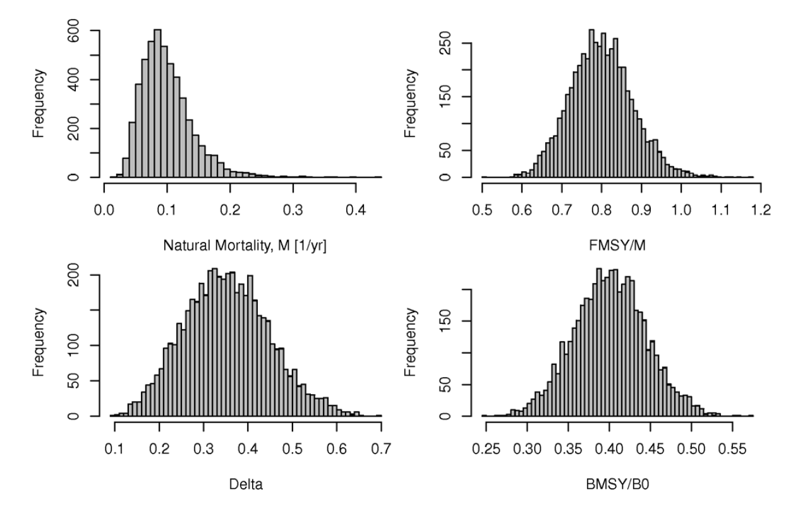
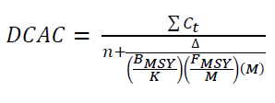
Improvement on average catch
An extension of Y_{opt}=0.5*M*B₀
“Windfall” harvest: one-time, non-sustainable catch
DCAC = ΣCatch/(n + W)
MacCall 2009. ICES J. Mar. Sci 66: 2267-2271

Slide 13

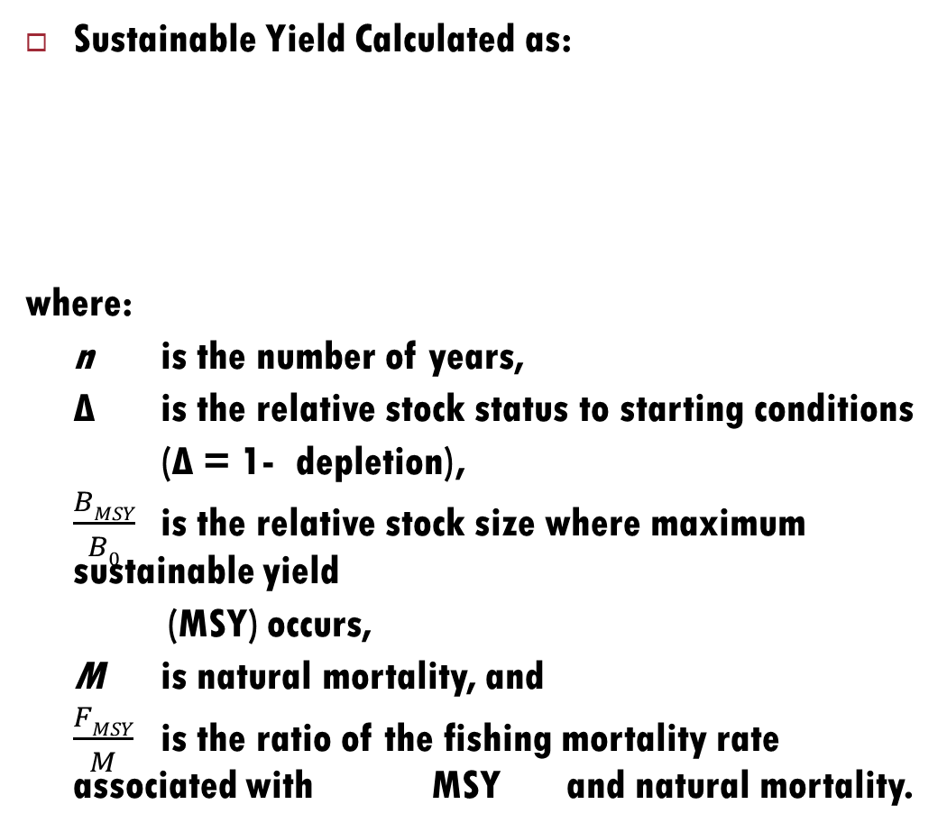
Methods: Depletion-Corrected Average Catch
DCAC
Sustainable Yield Calculated as:
where:
n is the number of years,
∆ is the relative stock status to starting conditions
(∆ = 1- depletion),
$\frac{BMSY}{B0}$ is the relative stock size where maximum sustainable yield
(MSY) occurs,
M is natural mortality, and
$\frac{FMSY}{M}$ is the ratio of the fishing mortality rate associated with MSY and natural mortality.
MacCall 2009
U.S. Department of Commerce | National Oceanic and Atmospheric Administration | NOAA Fisheries | Page 13

Slide 14
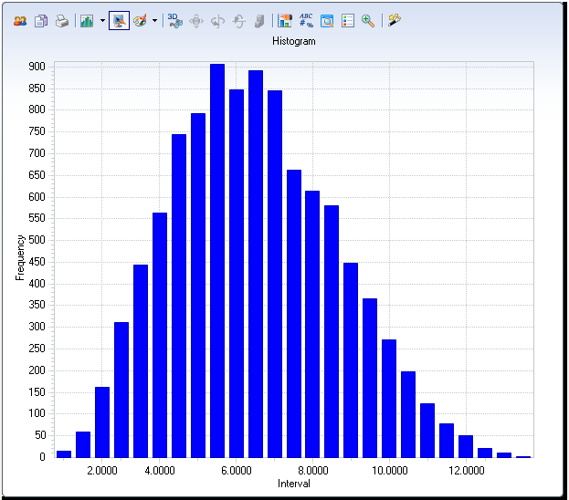
DCAC Example: Widow Rockfish (1988)
127Kmt caught 82-88
Δ = 0.5
M = 0.15
B_{MSY}/K = 0.4
F_{MSY}/M = 0.8
Avg. catch = 15.9 Kmt
Established quota of 12.1Kmt
Assumed sustainable
DCAC = 4 to 8 Kmt

Slide 15
DCAC
One time calculation
Gives a sustainable catch, not an MSY
Often much more conservative than stock assessments
Sensitive to depletion assumption
Only applicable if M<0.2

Slide 16
Now let’s add more information: the entire time series of catch. What can you do with this?

Slide 17
Depletion-Based Stock Reduction Analysis (DB-SRA) (Dick and MacCall 2010)
Incorporates full stock dynamics.
Relies on specifying a plausible range of “scaled” production parameters and depletion levels in the form of prior distributions.
Requires a comprehensive catch history (full history of the fishery).
Uses the other inputs used in DCAC.
Notes:
Preferred approach is …
> Slide <
Stress – requires a complete catch history which is unlikely for many fisheries.
Next slide, please.

Slide 18
Monte Carlo simulations generate a set of plausible trajectories, resulting in distributions of reference points.
It’s strength is not determining stock status but in estimating yield estimation.
Allows for propagation of uncertainty.

Slide 19
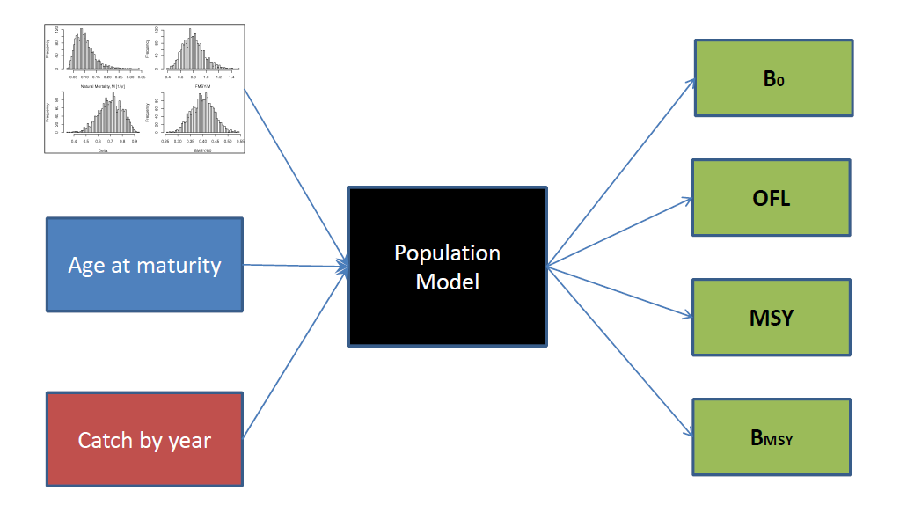

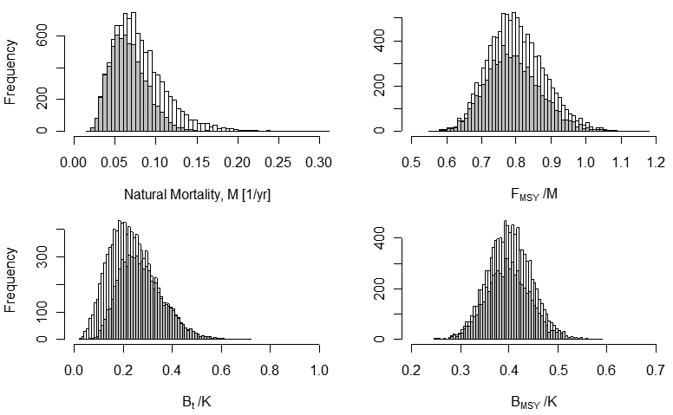
Methods: Depletion-Based Stock Reduction Analysis (DB-SRA)
Dick and MacCall 2010. Dick and MacCall 2011
U.S. Department of Commerce | National Oceanic and Atmospheric Administration | NOAA Fisheries | Page 19

Slide 20
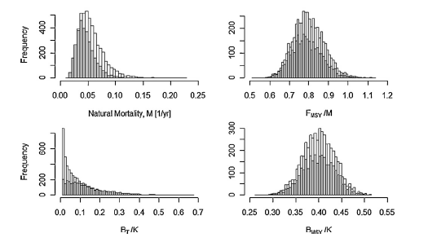

Slide 21
Martell and Froese (2012)
What’s required?
Prior distributions for r and k
Estimate of B/K at beginning and end of time series
Time series of catch

Slide 22
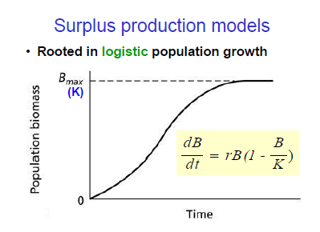

Slide 23
Which values of r and k would allow you to move from your initial biomass level to your final biomass level given your catch history?

Slide 24
Key equation
$$B_{t+1}=\left[B_{t}+r∗B_{t}∗\left(1−{B_{t}}/k\right)−c_{t}\right]∗exp\left(vt\right)$$

Slide 25
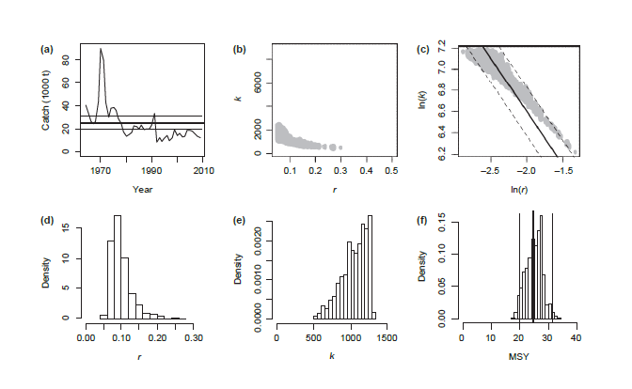
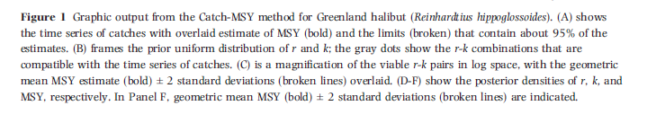

Slide 26
Method tends to overestimate k and underestimate r.

Slide 27
What are the assumptions with this method?
What are common problems with all of these methods?

Slide 28
Let’s try these methods out.

